Slide 1
Unit 4: Input/output Management
Time:7hrs
Presented by
Er.Harendra Bikram Shah (Lecturer)
Department of BCA NAST

Slide 2
OUTLINES
4.1 Principles of I/O Hardware-
I/O Device,
Device Controller,
Memory Mapped I/O,
Direct Memory Access
4.2 Principles of I/O Software-
Goals of I/O Software,
Polled I/O verses Interrupt Driven I/O,
Character User Interface and Graphical User Interface,
Device Driver,
Device Independent I/O Software,
User-space I/O Software
4.3 Mass Storage Structure
Overview of Mass Storage Structure
Disk Structure
Disk Attachment
Disk Scheduling
Disk Management
Swap space Management Redundant Array of Inexpensive Disks
RAM Disks
Optical Disk

Slide 3
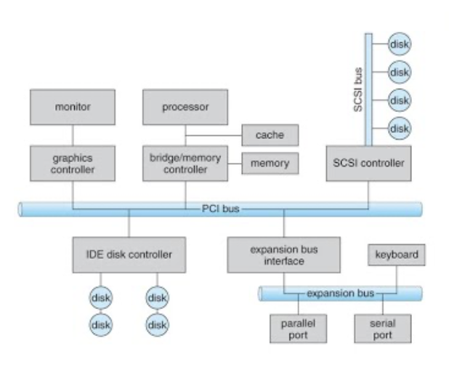
INTRODUCTION
Input/Output Management refers to the process of handling data inputs and outputs in a computer system.
This management is essential to ensure efficient communication between the system’s core components (such as CPU and memory) and external devices (like keyboards, storage devices, printers, and networks).

Slide 4
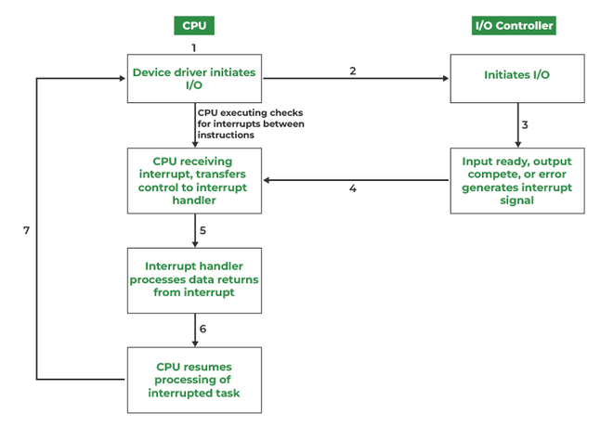
INTERRUPT
It is a signal emitted by hardware or software when a process or an event needs immediate attention.
It alerts the processor to a high-priority process requiring interruption of the current working process.
dedicated control line is called the Interrupt Service Routine (ISR).

Slide 5
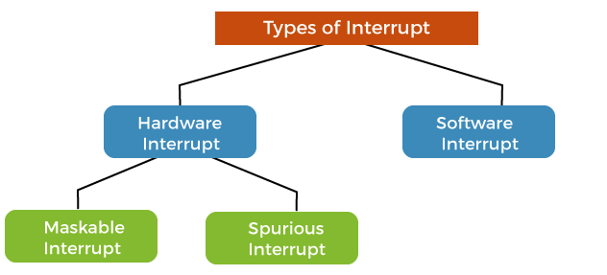
INTERRUPT

Slide 6
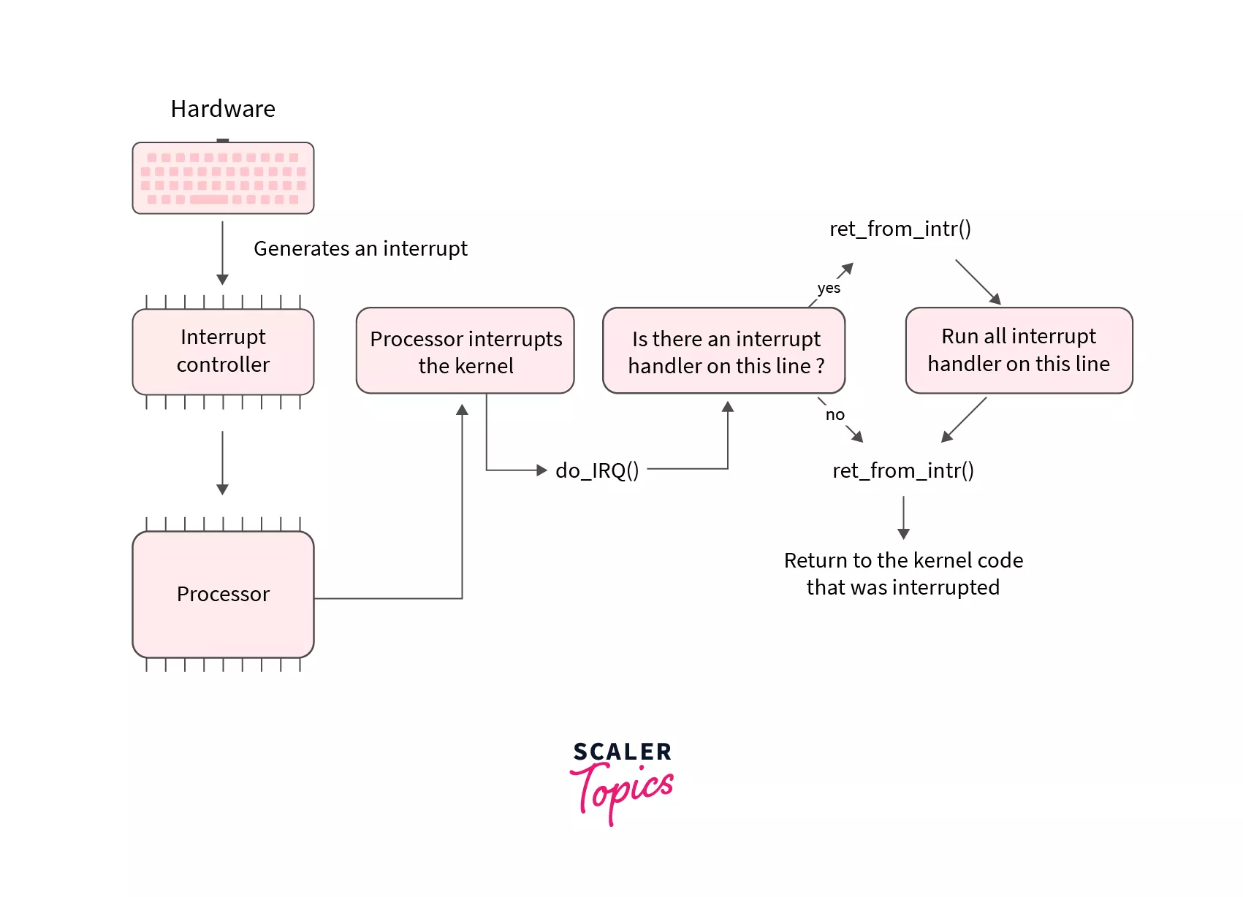
INTERRUPT HANDLING

Slide 7
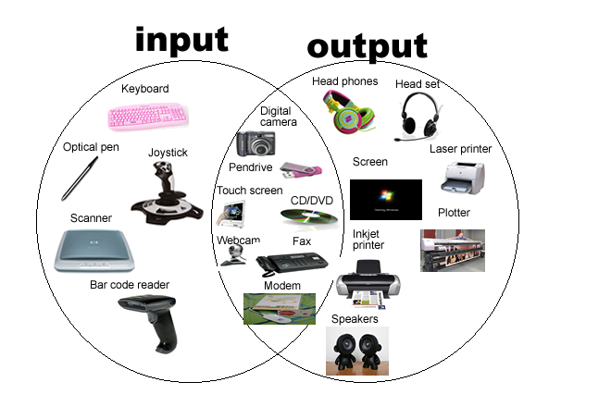
Principle of I/O Hardware

Slide 8
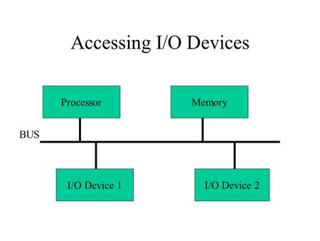
1. I/O Device
These are the devices that communicate with a computer system by sending signals over a cable.
The devices use a common set of wires, called bus, for communication
I/O devices can be of two types:
⮚Block Device: A device which stores information in fixed size blocks, each one with its own address is termed as block device.
Example: Disks are the most common block devices.
⮚Character Device: A character device delivers or accepts a stream of characters, without regard to any block structure
Example: printer, mouse, etc

Slide 9
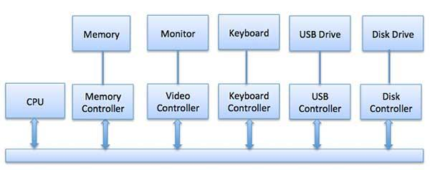
2. Device Controller
Device drivers are software modules that can be plugged into an OS to handle a particular device.
The Device Controller works like an interface between a device and a device driver.
I/O units (Keyboard, mouse, printer, etc.) typically consist of a mechanical component and an electronic component where electronic component is called the device controller.
There is always a device controller and a device driver for each device to communicate with the Operating Systems.

Slide 10
2. Device Controller
Function of device controllers:
⮚ Stops and starts the activity of the peripheral device.
⮚ Generate error checking code.
⮚ Checks the error in the data received from the interface.
⮚ Abort that command which have errors.
⮚ Retry the command having an error
⮚ Receives the control signals from the interface unit
⮚ Convert the format of the data
⮚ Check the status of the device

Slide 11
Communication to I/O Devices
Special Instruction I/O
Memory-mapped I/O
Direct memory access (DMA)
Special Instruction I/O
This uses CPU instructions that are specifically made for controlling I/O devices.
These instructions typically allow data to be sent to an I/O device or read from an I/O device.

Slide 12
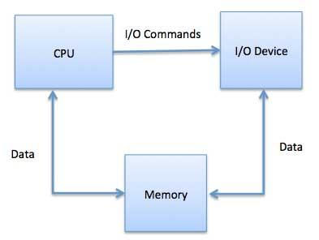
Memory Mapped I/O
Technique used in computer systems to communicate with I/O devices by mapping their control and data registers into the system's main memory address space.
This allows the CPU to interact with these devices using standard memory instructions.
Working of Memory-Mapped I/O:
Devices have control registers and data registers
These registers are assigned specific memory addresses.
The CPU reads from or writes to these addresses to perform I/O operations.
Applications
Modern computer systems (like x86 and ARM architectures)
MMIO is common in embedded systems.

Slide 13
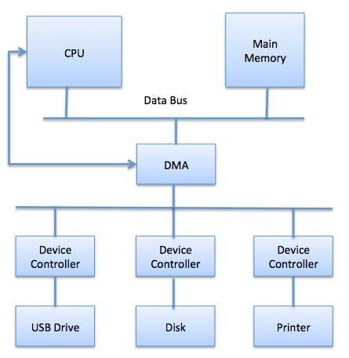
Direct Memory Access (DMA)
It is a feature used in computer systems to allow I/O devices to transfer data directly to or from the main memory without continuous CPU involvement.
DMA module itself controls exchange of data between main memory and the I/O device.
CPU is only involved at the beginning and end of the transfer and interrupted only after entire block has been transferred.

Slide 14
Direct Memory Access (DMA)
Types of Direct Memory Access (DMA)
Single-Ended DMA: reading and writing from a single memory address.
Dual-Ended DMA: read and write from two memory addresses.
Arbitrated-Ended DMA: reading and writing to several memory addresses.
Interleaved DMA: read from one memory address and write from another memory address.
Modes of Data Transfer in DMA
Burst Mode: In this buses are handed over to the CPU by the DMA if the whole data is completely transferred.
Cycle Stealing Mode: In this buses are handed over to the CPU by the DMA after the transfer of each byte
Transparent Mode: does not require any bus in the transfer of the data as it works when the CPU is executing the transaction.

Slide 15
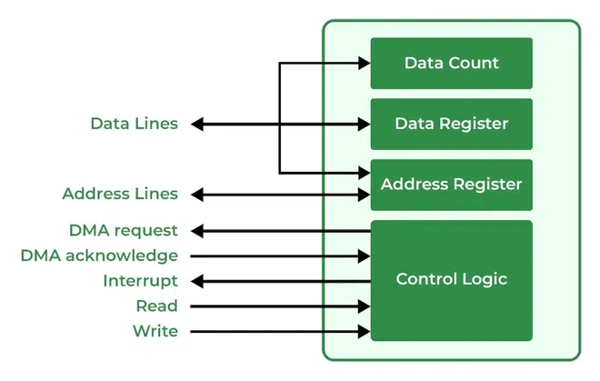
Direct Memory Access (DMA) Controller

Slide 16
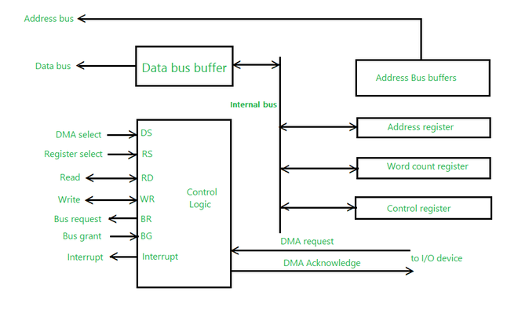
WORKING OF Direct Memory Access (DMA) Controller

Slide 17
WORKING OF Direct Memory Access (DMA) Controller
Advantages of DMA Controller
Data Memory Access speeds up memory operations and data transfer.
CPU is not involved while transferring data.
DMA requires very few clock cycles while transferring data.
DMA distributes workload very appropriately.
DMA helps the CPU in decreasing its load.
Disadvantages of DMA Controller
Direct Memory Access is a costly operation because of additional operations.
DMA Controller increases the overall cost of the system.
DMA Controller increases the complexity of the software.

Slide 18
PRINCIPLE OF I/O Software
Goals of I/O Software
Device Independence:
Uniform Naming:
Error Handling:
Buffering:
Provide a Device Independent Block Size:

Slide 19
Polling
Method where a device continuously checks the status of another device to determine if it needs attention.
Advantages :
Simplicity:
Compatibility:
Predictability:
Disadvantages
Resource Intensive:
Latency:
Complexity in Real-Time Systems:

Slide 20
Polling VS Interrupt
Features | Interrupt | Polling
Definition | An interrupt is an occurrence that signals the CPU to do a certain action and is caused by components outside the CPU. | A synchronous process in which a client program checks the status of an external device is known as polling.
Basic | The device determines the processor that it requires CPU attention. | The CPU regularly checks the device status and whether it requires the processor's attention.
Indication | The interrupt-request line serves as a signal for interrupts. | The Command-ready bit signifies that the device requires to be serviced.
Mechanism | It is a hardware Mechanism. | It is a Protocol.
Efficiency | Interrupts become inefficient when devices constantly interrupt CPU operations. | It becomes wasteful when the CPU continues to poll the gadget and rarely finds any gadget ready for servicing.
CPU cycles | The CPU is only interrupted when a device requires servicing, which saves CPU cycles. | The CPU must wait to determine whether a device requires servicing, which consumes many CPU cycles.
Occurrence | An interrupt happens at any time. | The CPU keeps polling the device at regular intervals.
Servicing | The device is serviced by the interrupt handler. | The CPU services the gadget.

Slide 21
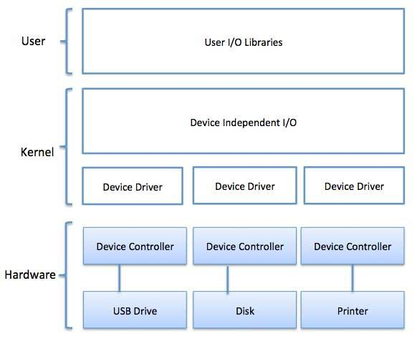
I/O Software

Slide 22
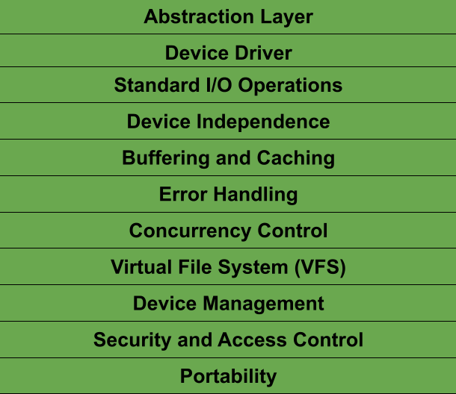
Device Independent I/O
Features of Device I/O Software

Slide 23
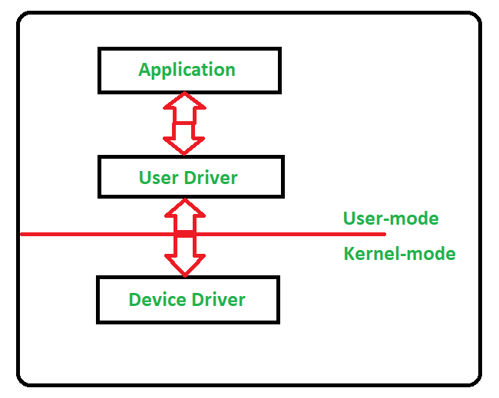
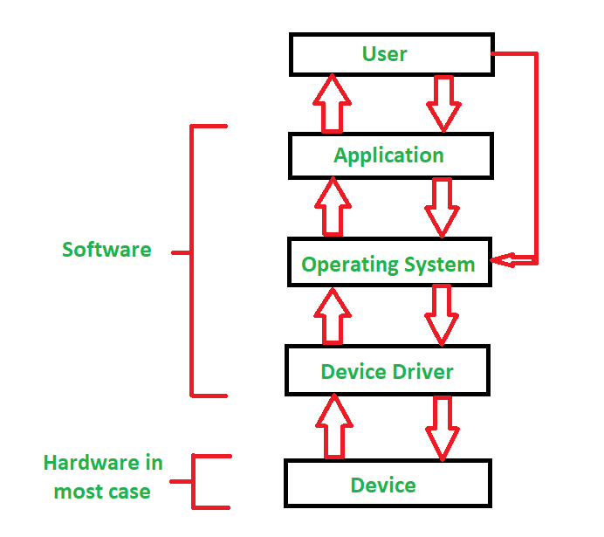
Device Drivers

Slide 24
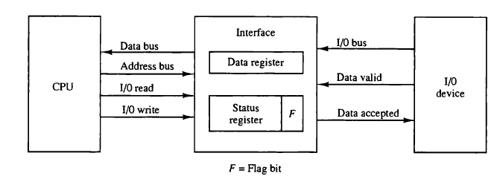
PROGRAMMED I/O
Technique where the CPU has to do all the work is called programmed I/O.

Slide 25
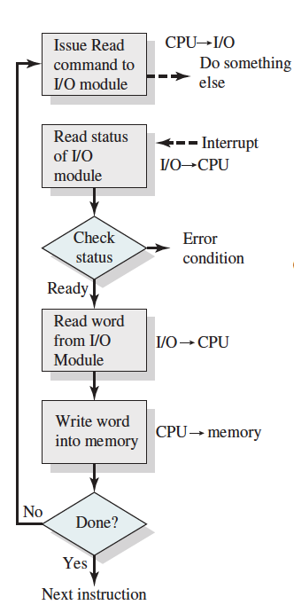
Interrupt Driven I/O

Slide 26
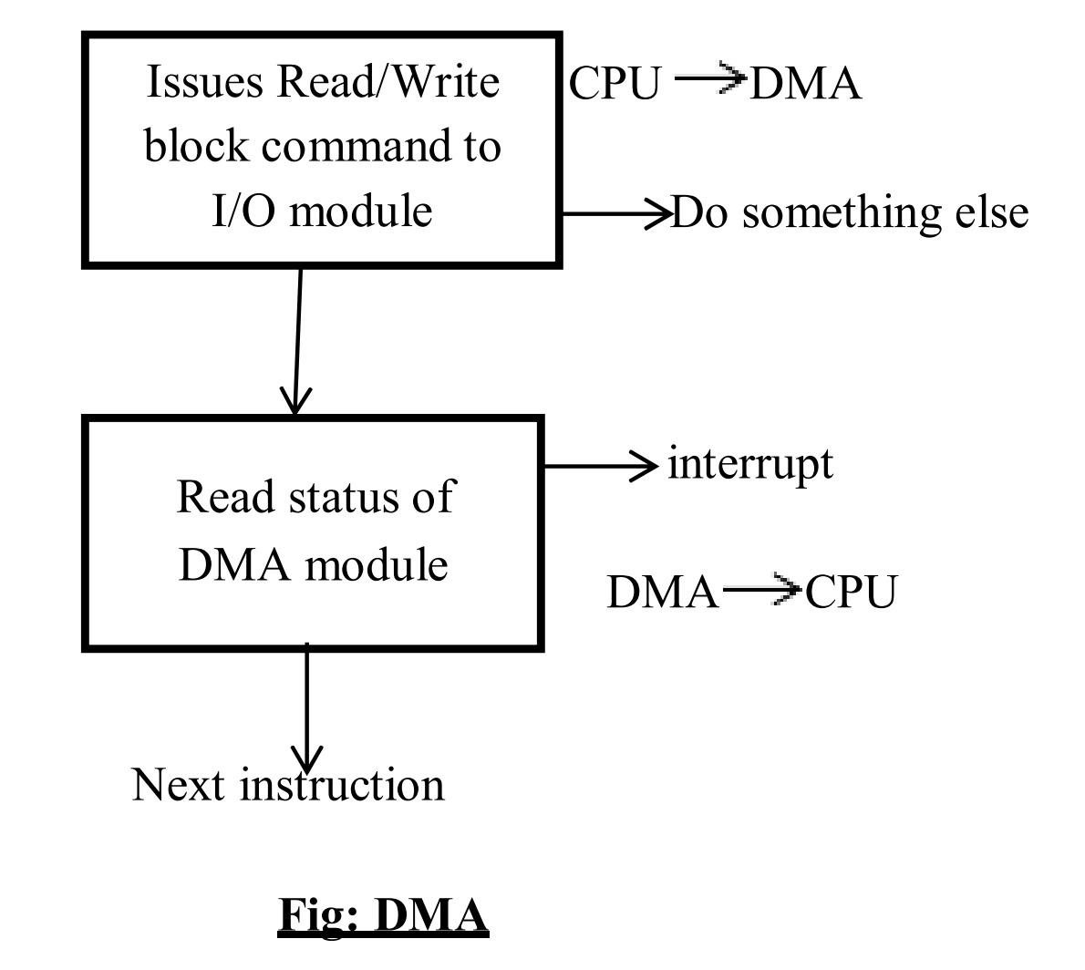
I/O Using DMA

Slide 27
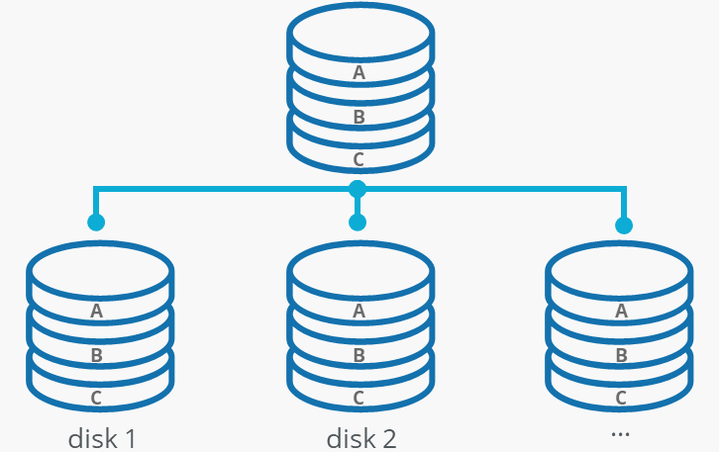
Redundant array of Independent disk
technique that makes use of a combination of multiple disks for storing the data instead of using a single disk for increased performance, data redundancy, or to protect data in the case of a drive failure.
The term was defined by David Patterson, Garth A. Gibson, and Randy Katz at the University of California, Berkeley in 1987
Working
Splitting
Making Copies

Slide 28
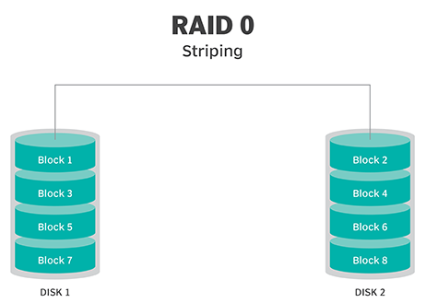
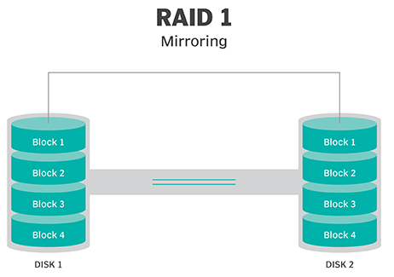
TYPES OF RAID

Slide 29
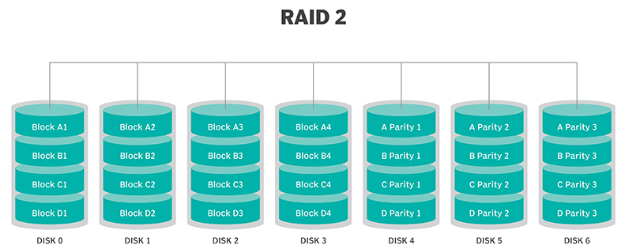
TYPES OF RAID
striping across disks, with Parity

Slide 30
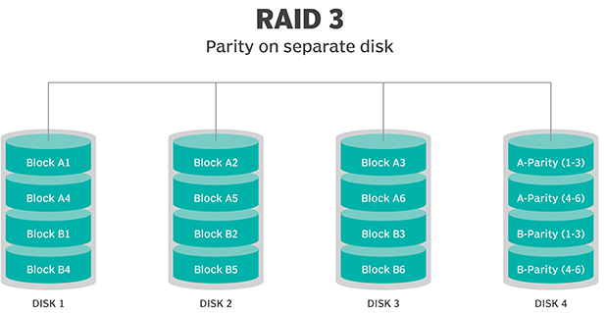
TYPES OF RAID
uses striping and dedicates one drive to storing Parity

Slide 31
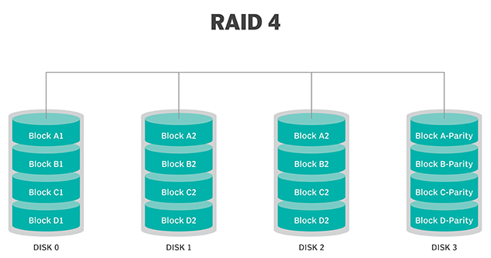
TYPES OF RAID
uses large stripes, which means a user can read records from any single drive.

Slide 32
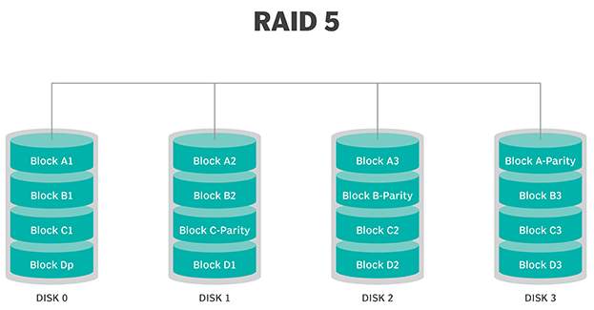
TYPES OF RAID
based on parity block-level striping. The parity information is striped across each drive

Slide 33
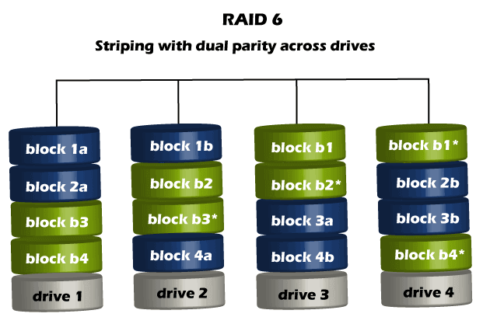
TYPES OF RAID

Slide 34
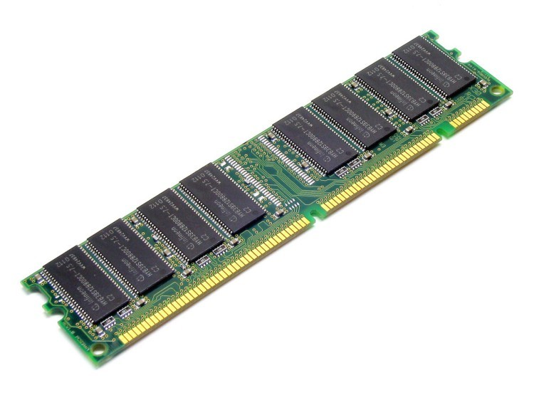
RAM DISK
Benefits
Ultra-Fast Read and Write Speeds:
Reduced Latency:
Reduced Wear on SSDs:
Drawbacks
Volatility:
Resource Usage:
Limited Size:

Slide 35
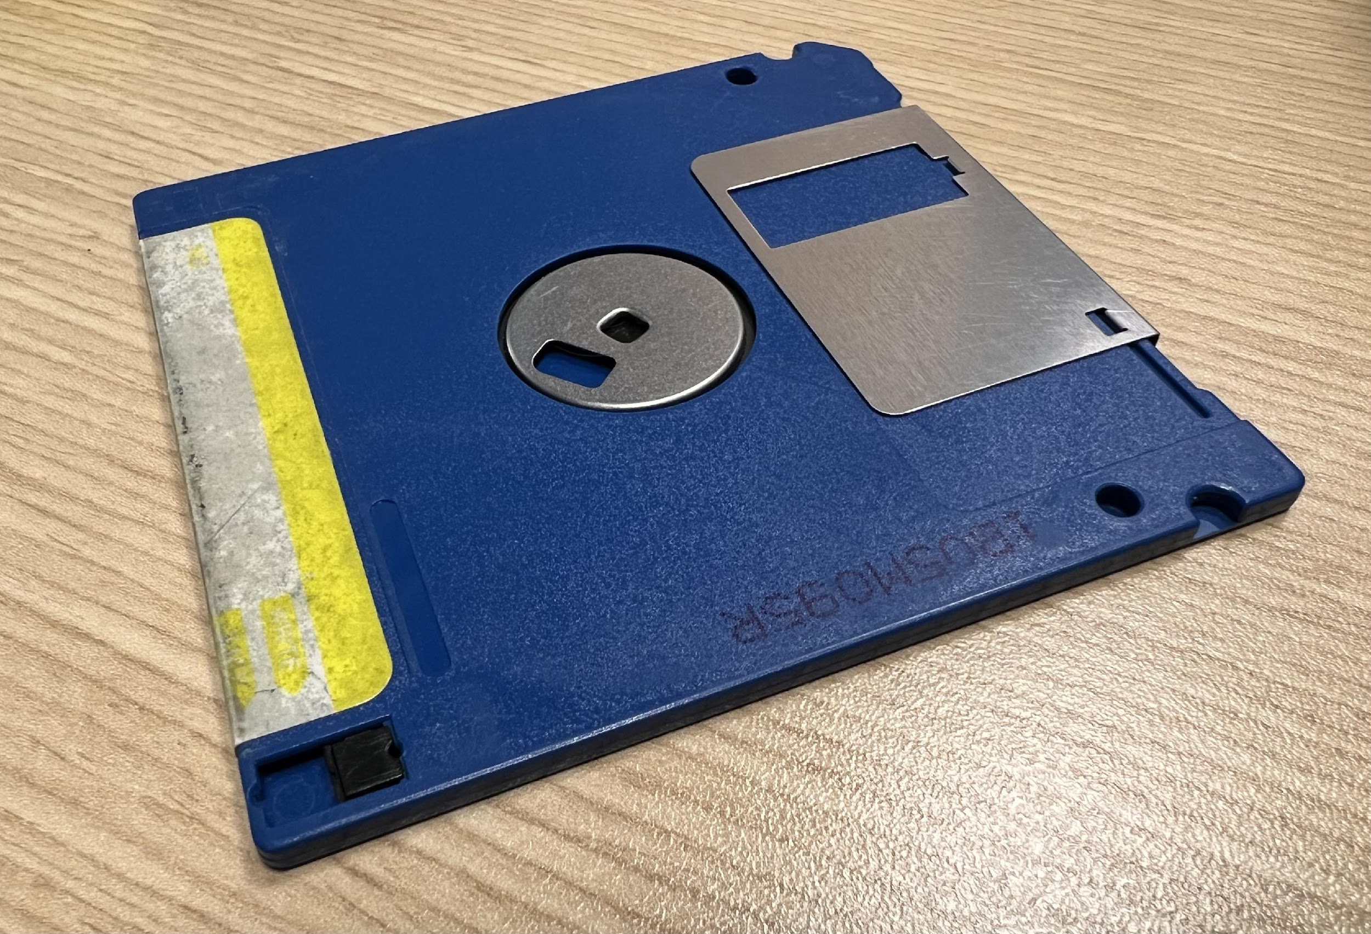
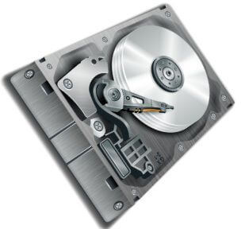
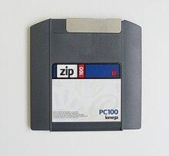
Mass Structure
Systems designed to store enormous volumes of data are referred to as mass storage devices.
The Mass Storage Structure Devices are:
Magnetic Disks
Solid State Disks
Magnetic Tapes
Basic Common Examples of Magnetic Disks are:
Floppy Disks
Hard Disks
Zip Disks

Slide 36
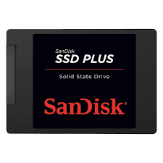
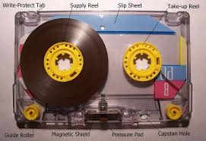
Mass Structure
Solid State Disks
Magnetic Tapes

Slide 37
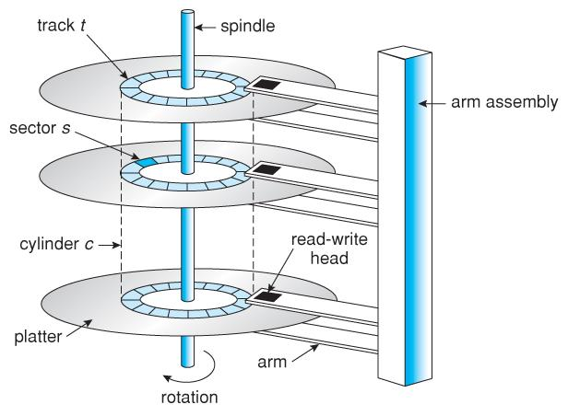
Disk Structure

Slide 38
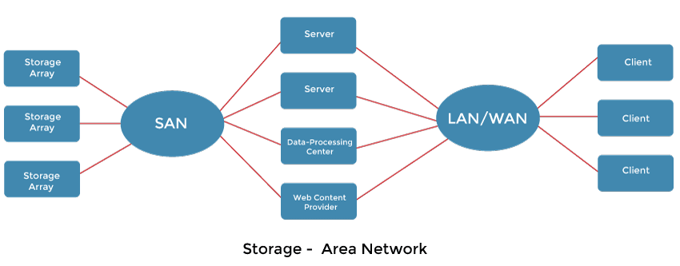
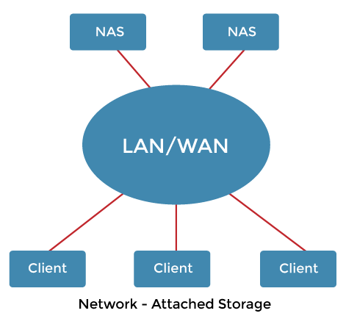
Disk Attachment
There are two ways for computers to access disc storage.
One method is to use I/O ports, also known as host-attached storage, on small systems.
Another method is through a remote host in a distributed file system, which is known as network-attached storage.

Slide 39
DISK MANAGEMENT
Disk management is one of the critical operations carried out by the OS.
It deals with organizing the data stored on the Secondary Storage devices which includes the hard disk drives and the solid-state drives
Disk Management of the Operating System Includes:
Disk Format
Booting from disk
Bad block recovery
Advantages of disk management include:
Improved organization and management of data.
Efficient use of available storage space.
Improved data integrity and security.
Disadvantages of disk management include:
Increased system overhead due to disk management tasks.
Increased complexity in managing multiple partitions and file systems.
Increased risk of data loss due to errors during disk management tasks.

Slide 40
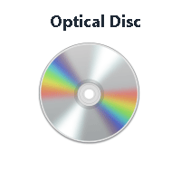
Optical Disk
Applications of Optical Disk
Data Security:
Software Distribution:
Data Transfer:
Medical Imaging:
Educational Resources:

Slide 41
Disk Scheduling Algorithm
FCFS (First Come First Serve)
SSTF (Shortest Seek Time First)
SCAN
C-SCAN
LOOK
C-LOOK

Slide 42
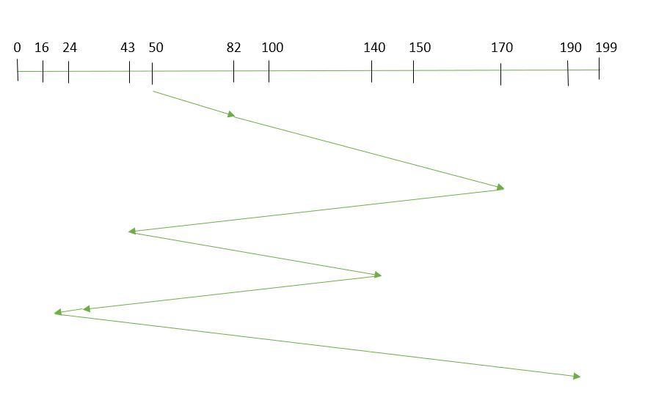
Disk Scheduling Algorithm
1. FCFS (First Come First Serve)
Suppose the order of request is- (82,170,43,140,24,16,190) And current position of Read/Write head is: 50

Slide 43
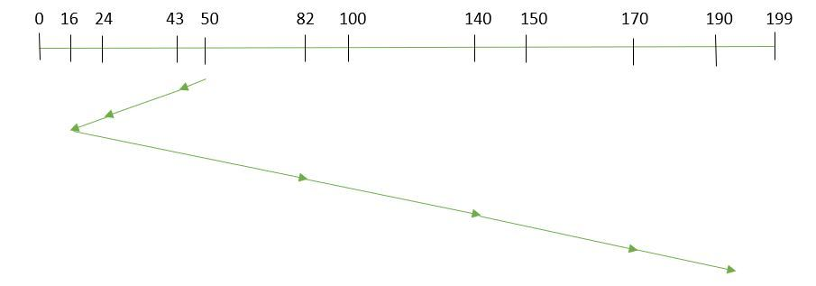
Disk Scheduling Algorithm
2. SSTF (Shortest Seek Time First)
Suppose the order of request is- (82,170,43,140,24,16,190) And current position of Read/Write head is: 50

Slide 44
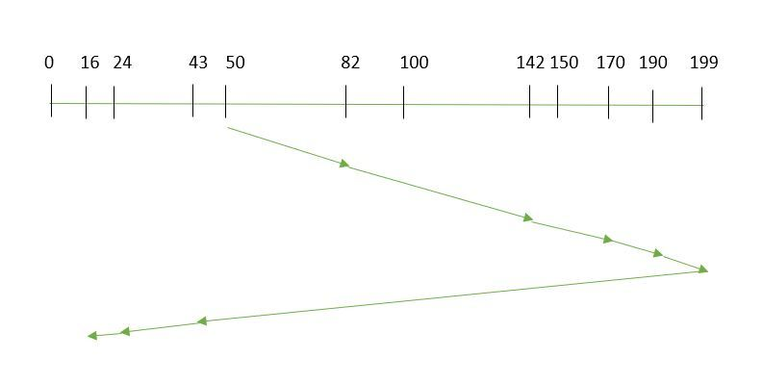
Disk Scheduling Algorithm
3. SCAN
Suppose the requests to be addressed are-82,170,43,140,24,16,190. And the Read/Write arm is at 50
Therefore, the total overhead movement (total distance covered by the disk arm) is calculated as
= (199-50) + (199-16) = 332

Slide 45
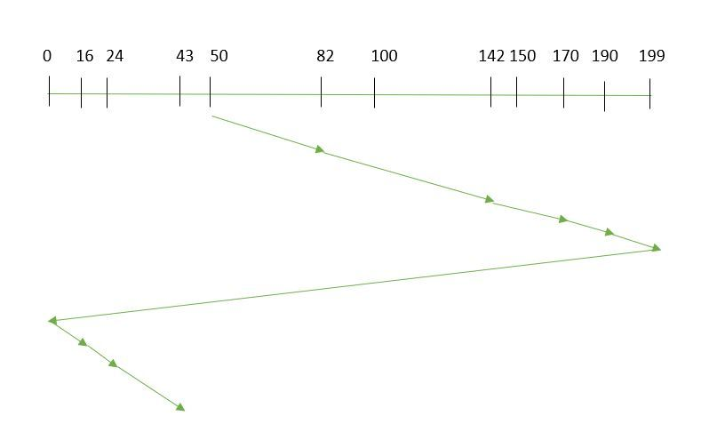
Disk Scheduling Algorithm
4. C-SCAN
Suppose the requests to be addressed are-82,170,43,140,24,16,190. And the Read/Write arm is at 50
So, the total overhead movement (total distance covered by the disk arm) is calculated as:
=(199-50) + (199-0) + (43-0) = 391

Slide 46
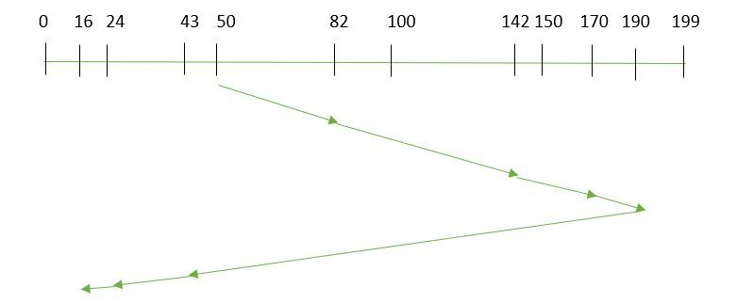
Disk Scheduling Algorithm
5. LOOK
Suppose the requests to be addressed are-82,170,43,140,24,16,190. And the Read/Write arm is at 50
So, the total overhead movement (total distance covered by the disk arm) is calculated as:
= (190-50) + (190-16) = 314

Slide 47
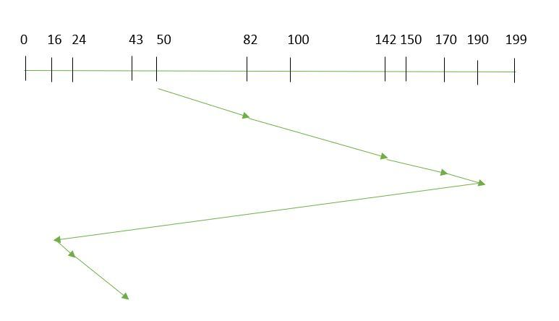
Disk Scheduling Algorithm
6. C-LOOK
Suppose the requests to be addressed are-82,170,43,140,24,16,190. And the Read/Write arm is at 50,
So, the total overhead movement (total distance covered by the disk arm) is calculated as
= (190-50) + (190-16) + (43-16) = 341

Slide 48
THANK YOU

Slide 49
THANK YOU

